Slide 1
TwinStrand Panel – v2
Jason Kunisaki
2/12/2021

Slide 2
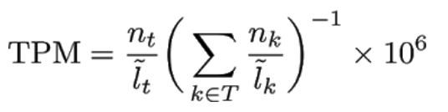
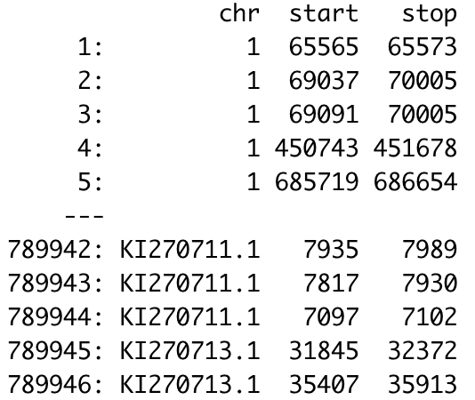


Important files
GTF file
gene_names
gene_ids
transcript_ids
exon positions
APPRIS file
Functionally important isoforms/transcripts
Proteomics
Cross-species conservation
GTEx file
Tissue specific gene expression
~330 testis samples
Manuel Rodriguez et al, 2017

Slide 3
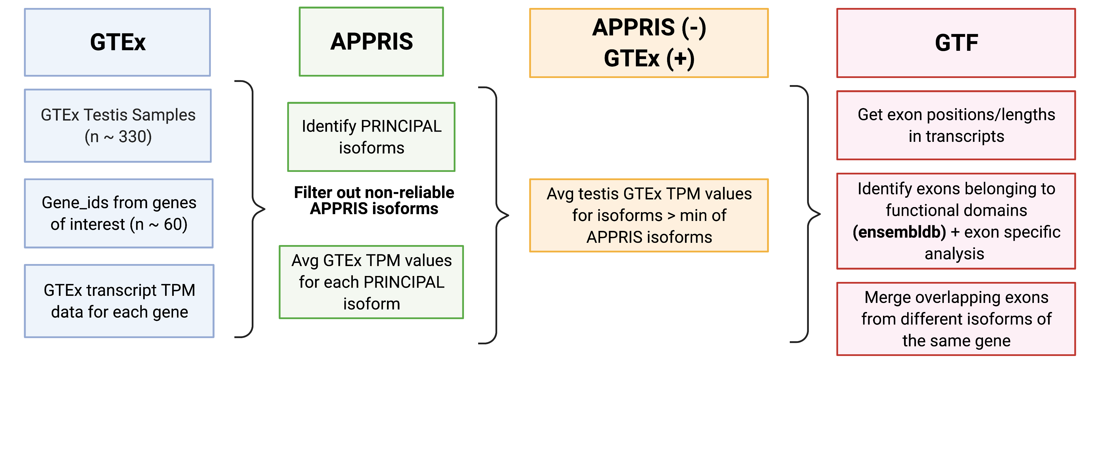
General Analysis Overview

Slide 4
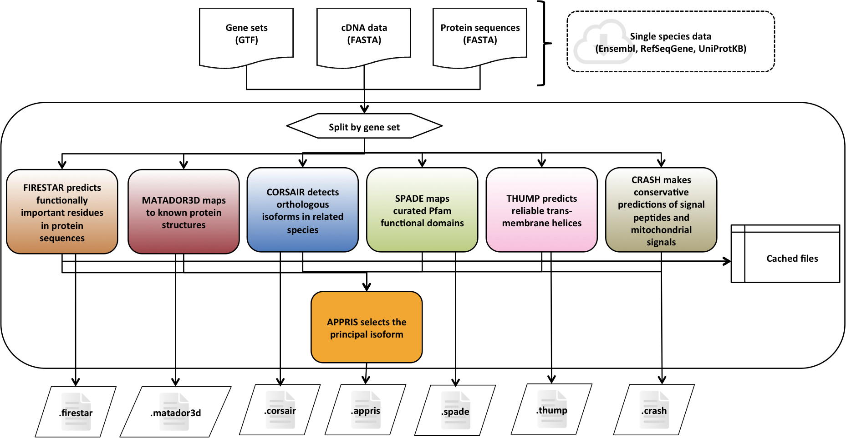
APPRIS – Functionally Important Isoforms

Slide 5
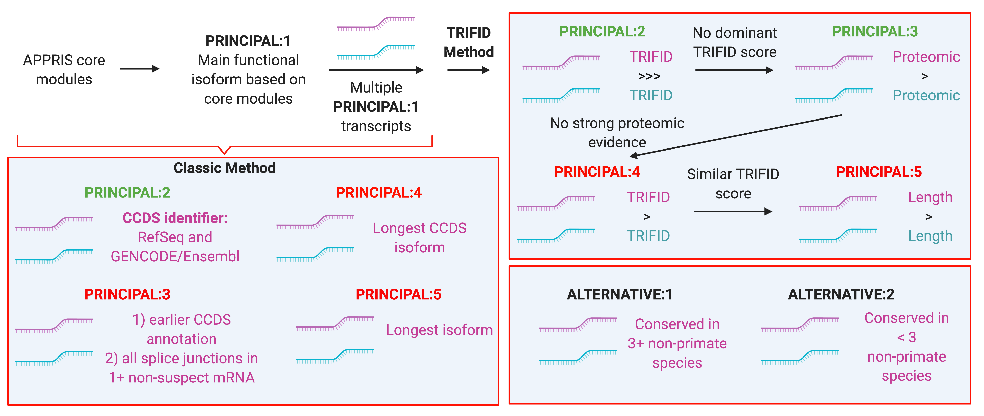
APPRIS – Principal Isoform Flags
NOTE:
Multiple transcripts can have same CoDing Sequence (CDS)

Slide 6
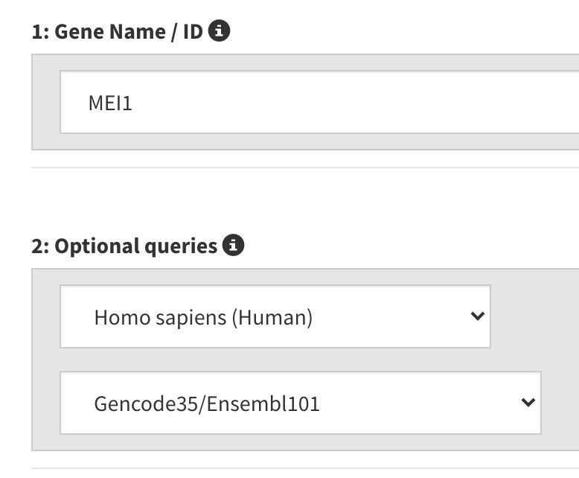
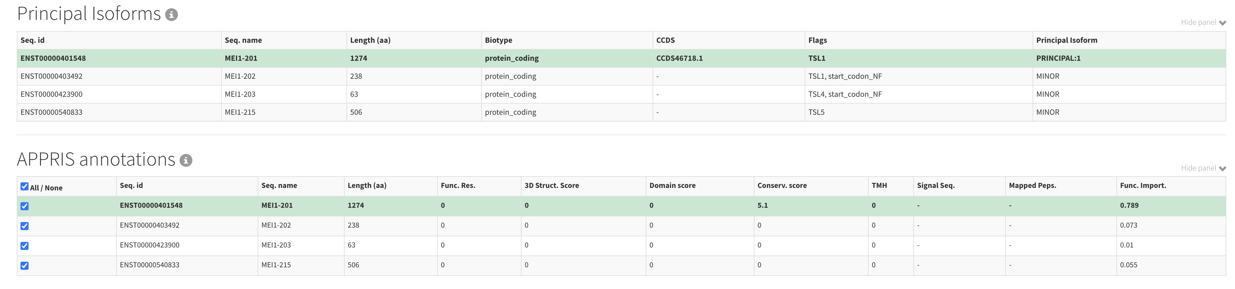
APPRIS – Example with MEI1
MEI1 Genome Browser Link

Slide 7
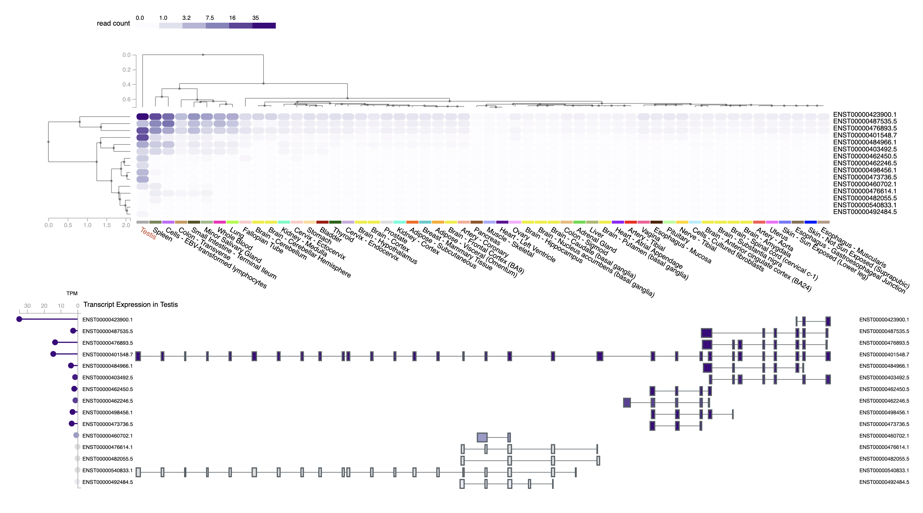
GTEx – Target Gene Expression in Testis
GTEx – Example with MEI1

Slide 8
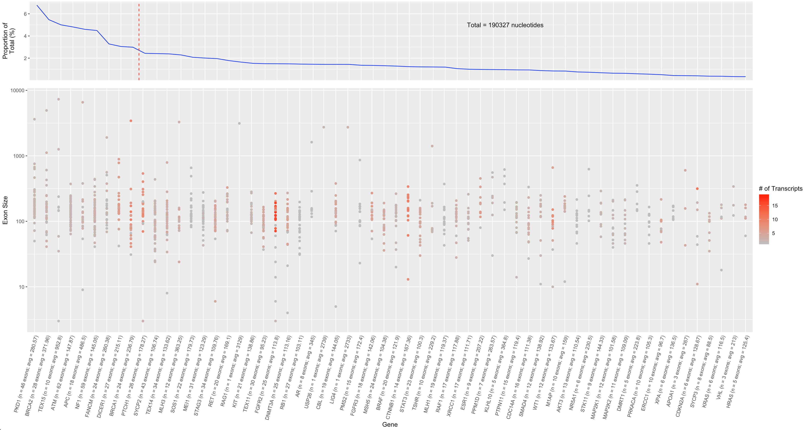
Notes:
Make another plot --> proportion of total # of bp that each gene eats up
DAZZLE

Slide 9
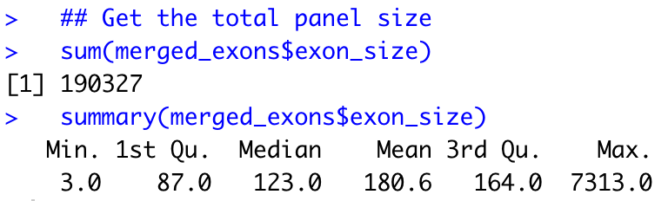
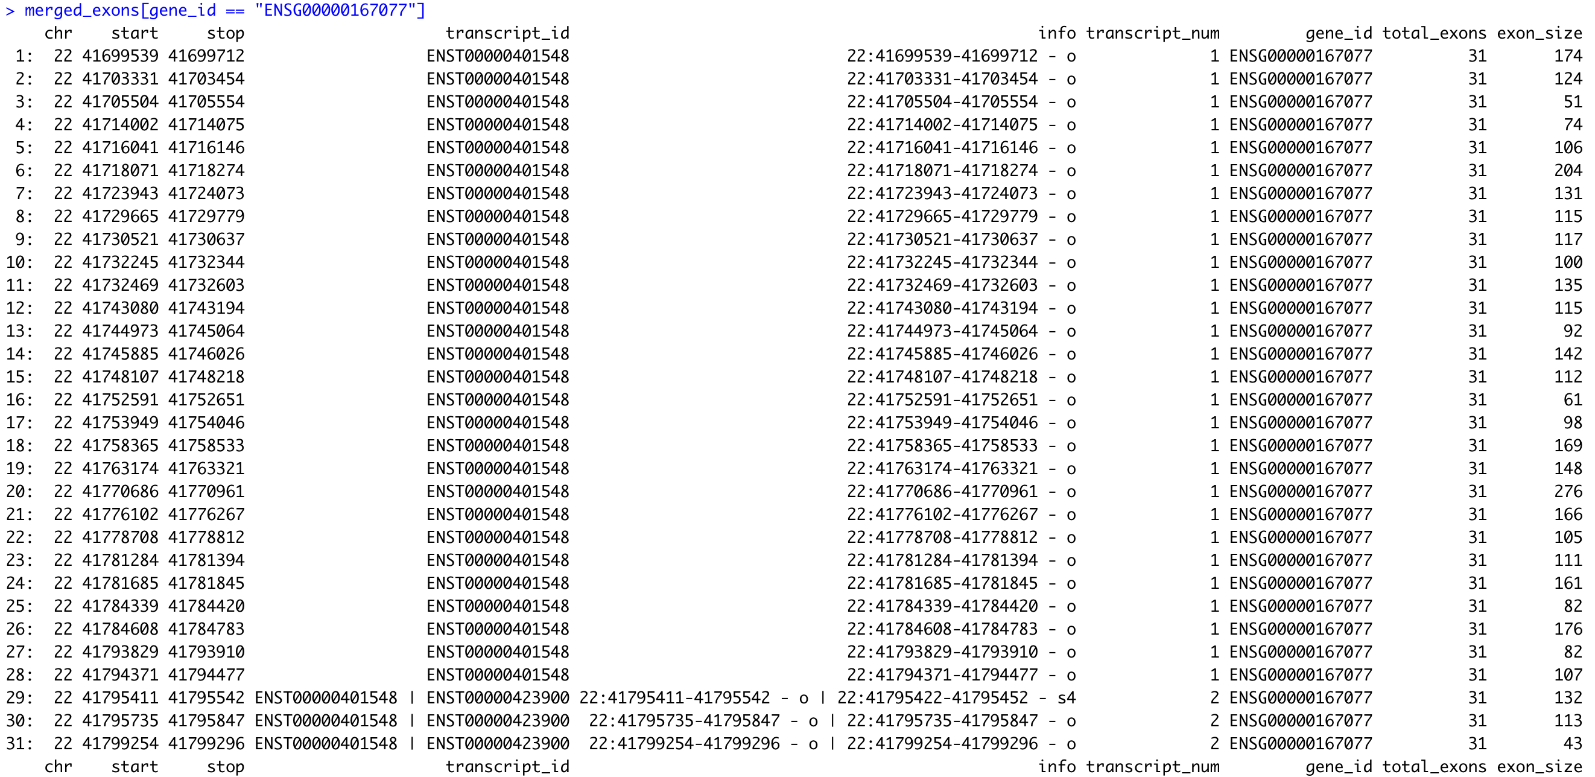
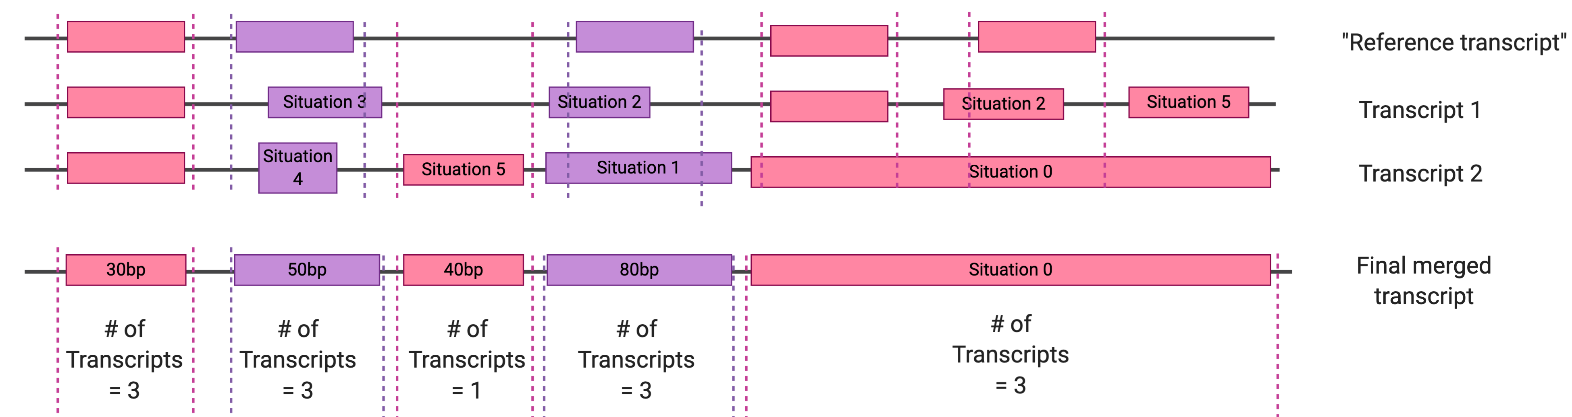
1
1
1
1
2
2
2
2
3
3
1
3
3

Slide 10
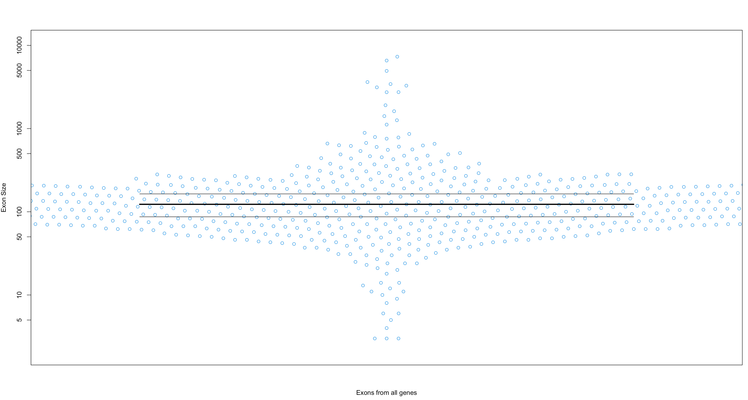

Slide 11
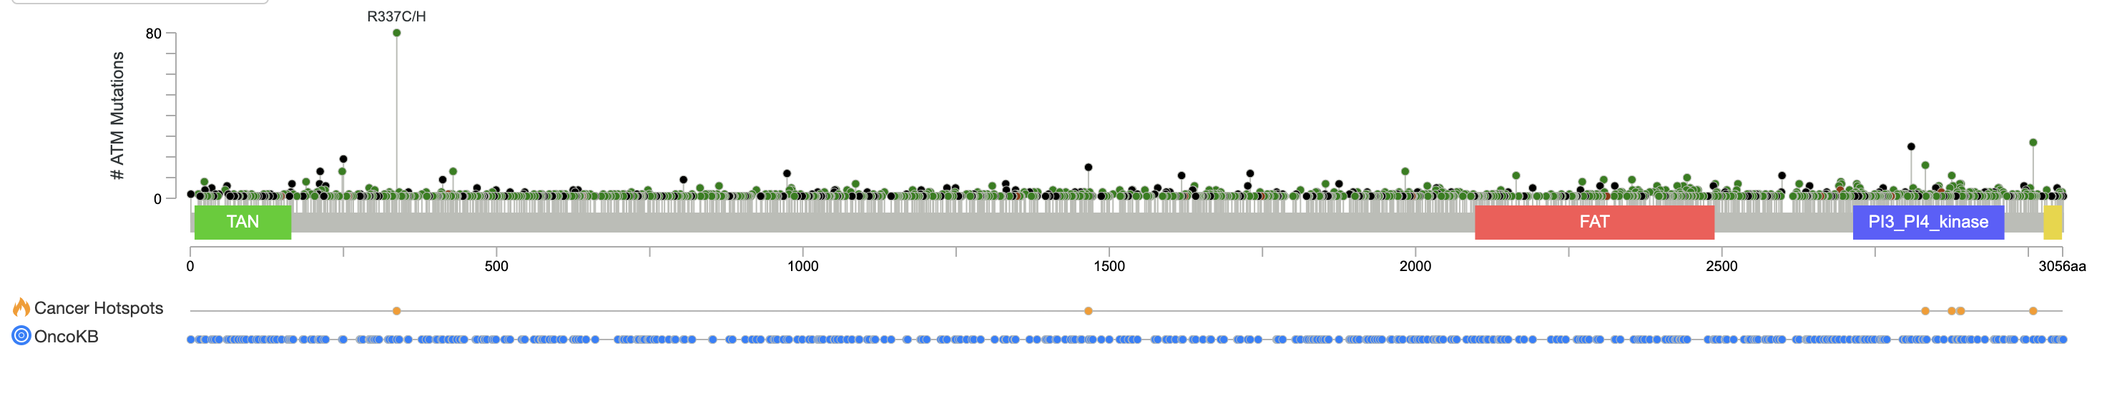
How to select exons to look at?
Gene: ATM (ENST00000278616 – transcript id)
Exons associated with Pfam functional domains (transcript specific)
Ensembldb R package
UCSC Genome Browser – could not specify transcript id
Exons harboring cancer hotspot mutations
Convert protein coordinate → genomic coordinates
ProteinToGenome function in ensembldb R package
Exon GC content

Slide 12
Caveats with the analysis
Still need to check for many, many bugs
Can one exon contribute to multiple pfam domains in the same transcript?
Why were CDS sequences not attainable for some transcript_ids? → could not get accurate genomic coordinates from protein coordinates…
Some genes were not in GTEx
H3F3A
H3F3B
Does not include AZF genes
Notes:
note how many samples have TPM values > 1

Slide 13
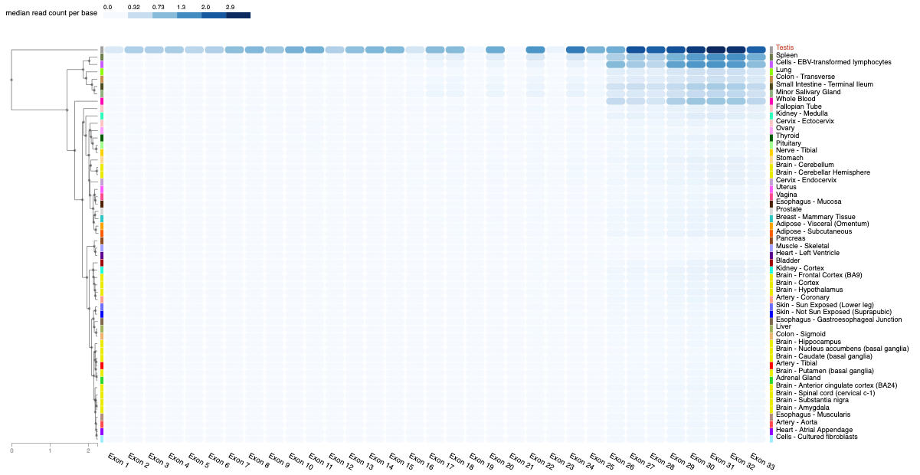
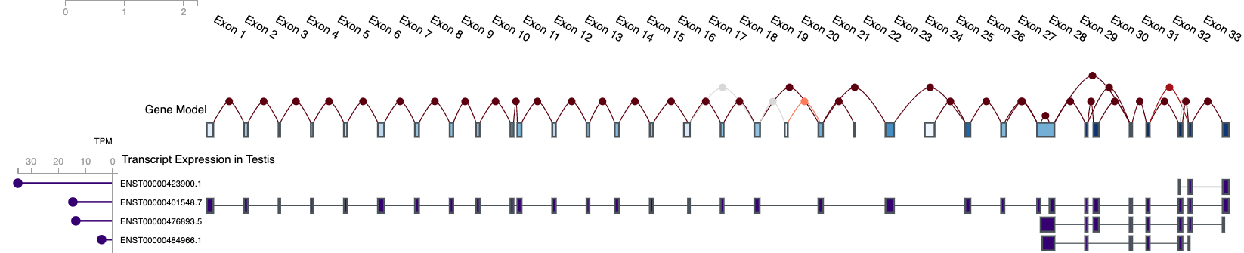
Next steps for TwinStrand panel design
How to prioritize exons:
Selfish mutations → use similar panel as Maher et al (https://genome.cshlp.org/content/28/12/1779/T1.expansion.html)
Cancer genes? Autism risk genes?
Cancer hotspot mutations? Any mutation in cancer gene?
COSMIC
cBioPortal
ClinVar
Exon expression from GTEx
Make sure testis samples from GTEx are from healthy men? Or still use men with testicular cancer (e.g. from cBioPortal)?
MEI1

